Slide 3
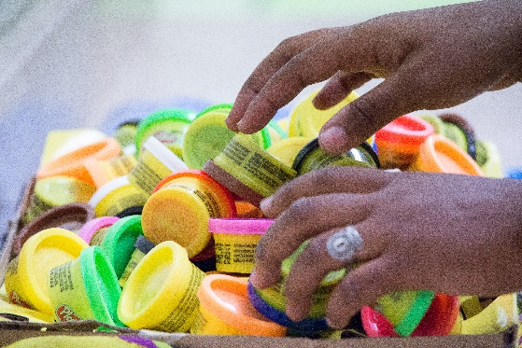
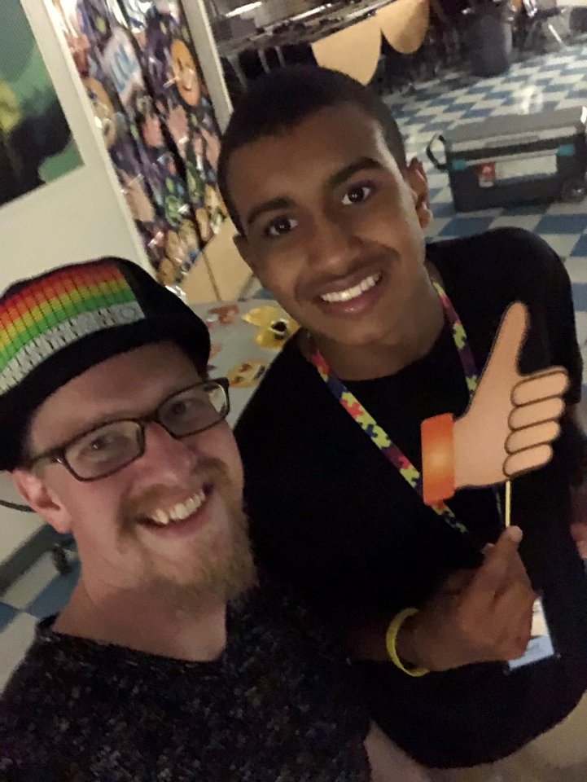
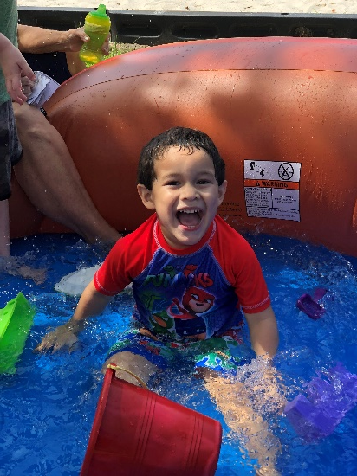
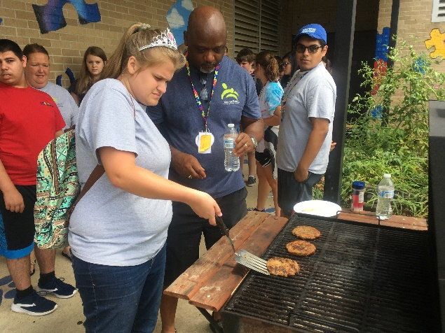
Camp By The Numbers
Founded in 2003
First Learning Lab in 2007
To date, we have provided training for more than 340 educators and served more than 325 individuals with autism
Notes:
Kids for Camp is a summer learning lab for children, teens, and young adults on the autism spectrum. This day program provides fun and intensive learning experiences for children with autism, as well as training for educators from our area.
Kids for Camp was created in 2003 by Mrs. Judy Burns. At that time she was looking for summer programs for both of her sons. While there were many options for her neuro-typical son, she found that nothing was available for her son with autism. So she took matters into her own hands, partnered with Autism Pensacola, and with help from Gulf Breeze Presbyterian Church and Gulf Breeze Rotary Club, created Kids for Camp.
In 2007, Kids for Camp expanded from being simply a summer camp to a summer learning lab. API began providing educators with training on best practices for teaching children with autism, and providing children on the spectrum with a high-quality educational program during the summer. Kids for Camp became nationally recognized that year as a program doing “what works” for children with autism.
Since then, Kids for Camp has continued to provide a high-quality program for individuals with autism, ages 2 through 25.

Slide 4
Doing “What Works”
APPLIED BEHAVIOR ANALYSIS - THE BASICS
Understanding (and modifying) behavior in the context of environment is the basis for ABA therapies.
ABA uses positive reinforcement in a way that can be measured in order to bring about meaningful behavior change.
Verbal Behavior motivates a child, teen, or adult to learn language by connecting words with their purposes.
Natural Environment Teaching (NET) is used at camp to teach targets. NET is teaching away from the table.
Camp focuses on the main skill deficits for most with autism: Communication and Social Skills
Intro to ABA video
Created by the Autism Center at Sacred Heart
Notes:
Our strategies are based on the principles of Applied Behavior Analysis (ABA). ABA uses scientifically validated principles, such as motivation, reinforcement and prompting to improve important behaviors. That means increasing skills we want to see while eliminating or decreasing those that interfere with learning and the ability to develop new skills.
Find an Introduction to ABA video, created by the Autism Center at Sacred Heart: https://www.youtube.com/watch?v=l9jFrBv4BKY&feature=youtu.be
#1 on P&P Autism Pensacola’s Kids for Camp is a data-driven program using best-practice techniques, specifically Applied Behavior Analysis, to contribute to both the skill acquisition of the individuals with autism and the continuing education of the teachers, support staff, and college students who work with those with autism. API is committed to continuously improve the camp experience, thus remaining a model of quality and integrity to the community.

Slide 5
COMMUNITY PARTNERSHIPS
Notes:
Kids for Camp is made possible through community partnerships, along with the support of generous people and businesses in the greater Pensacola area.
Major Partners
The Autism Center of The Studer Family Children’s Hospital at Sacred Heart
Escambia County School District
Capstone Adaptive Learning and Therapy Centers
Other Partners: FSU-Center for Autism and Related Disabilities, Santa Rosa County School District, The support of generous people and businesses in the greater Pensacola area

Slide 6
OUR PROGRAMS
Preschool - Elementary
PreK campus (Location TBD) – serves ages 2-3; uses Early Start Denver Model programming
Elementary campus @ Holm – serves ages 4-12 – works primarily on communication and social skills, following the VB-MAPP.
Middle school – Young Adults
Young Teens – serves ages 12-15 - works heavily on social skills and daily living skills, as well as early job skills.
JTP Teens– serves ages 16-19 - works on social communication, job skills and daily living skills.
Community Life Skills Program – serves young adults through age 25 - community- based programming
Notes:
#10 on P&P on hours and location
Introduce those leadership staff present
Fran BCBA
Debbie BCBA
Aileen, teacher, parent, Capstone principal
Assessment tools
Early Start Denver Model programming - The Early Start Denver Model follows a play-based approach that emphasizes the development of play skills, relationships, and language.
VB-MAPP - The Verbal Behavior Milestones Assessment and Placement Program (VB-MAPP) is an assessment and skills-tracking system to assess the language, learning and social skills of children with autism or other developmental disabilities.
AFLS – Assessment of Functional Living Skills is used to develop targets for our teens and young adults related to self-help, jobs, and community safety skills.

Slide 7
IMPORTANT DATES FOR CAMP
Kids for Camp runs June 10 through July 14
No camp on Fridays
Full Camp – 20 Days of Camp
June 10th through July 14th
or
1st ½ of camp – 10 Days of Camp
June 10th to June 25th
2nd ½ of camp – 10 Days of Camp
June 29th to July 14th
Notes:
Please Note: The options of camp dates are only available if there is enough interest, and if there is space available.
You will be notified before acceptance of any changes to the available options.

Slide 8
Parent partners
Best practice
Santa Rosa
ABA techniques
Summer progress
Teacher/Student ratio
JTP
CLS
Job training experiences
Training
Volunteer
Kids for Camp
Collaboration
success
Capstone
Escambia schools
partnership
Full day program
Holm
Field trips
Sacred Heart
Notes:
Let’s move into how to apply for camp
But – let’s remember what you’re getting when you come to Kids for Camp

Slide 9
Applications due by February 28th
Complete Packet includes …
Application form
Verification of autism diagnosis (New applicants only)
IEP, Behavior plan from ABA therapist
Current membership in Autism Pensacola
Application fee ($25 per application submitted)
Financial aid documentation
Application Process Guidelines
The application process steps:
1. Completed camper application received
2. Pre-camp mini skills assessment (required for all new applicants)
3. Follow up meeting with camp leadership staff
Notes:
#2 on Policies and Procedures
Checklist on the camp application details these requirements
Important Note: To be considered for acceptance, application must be turned in – and complete – before February 28th. Those applications received after February 28th are considered incomplete and will be at the bottom of the list for acceptance.
Membership - https://autismpensacola.org/get-involved/
Application Fee - https://autismpensacola.org/our-programs/kids-for-camp/
Application Process Guidelines: Camper applications go through a multi-step process to determine whether our program can safely meet a child’s needs. This process also helps us determine child’s level of support needed to be successful.
By submitting a camp application, parents are giving permission for child’s application to be reviewed by leadership staff. Camp staff also conduct the mini skills assessments. Parents are responsible for making sure child attends their scheduled session.
Assessments will be completed before end of March.

Slide 10
Tuition Rates
Pre-K Campus –
20-day camp option: $1,800 per camper
10-day camp option: $1,000 per camper
All other campuses -
20-day camp option: $2,000 per camper
10-day camp option: $1,100 per camper
Additional financial aid may be offered through Autism Pensacola, but amount varies each year based on fundraising results.
Notes:
To provide a high quality, individualized, summer learning opportunity, the average cost of camp is $3000 per camper
Through generous community donations, we are able to offer a tuition discount for all Escambia and Santa Rosa County residents. Families are encouraged to seek outside funding to cover tuition costs.
And opportunities for fundraising is available through Friends & Family. Additional financial aid may be offered through Autism Pensacola, but amount varies each year based on fundraising results.
#5 on P&P
If you would like to submit financial aid information, it MUST be submitted with application packet.
Families are encouraged to seek outside funding to cover tuition costs.
Agency for Persons with Disabilities (APD)
Center for Autism and Related Disabilities (CARD)
Friends & Family donations made in your child’s name
Additional financial aid may be offered through Autism Pensacola, but amount varies each year based on fundraising results

Slide 11
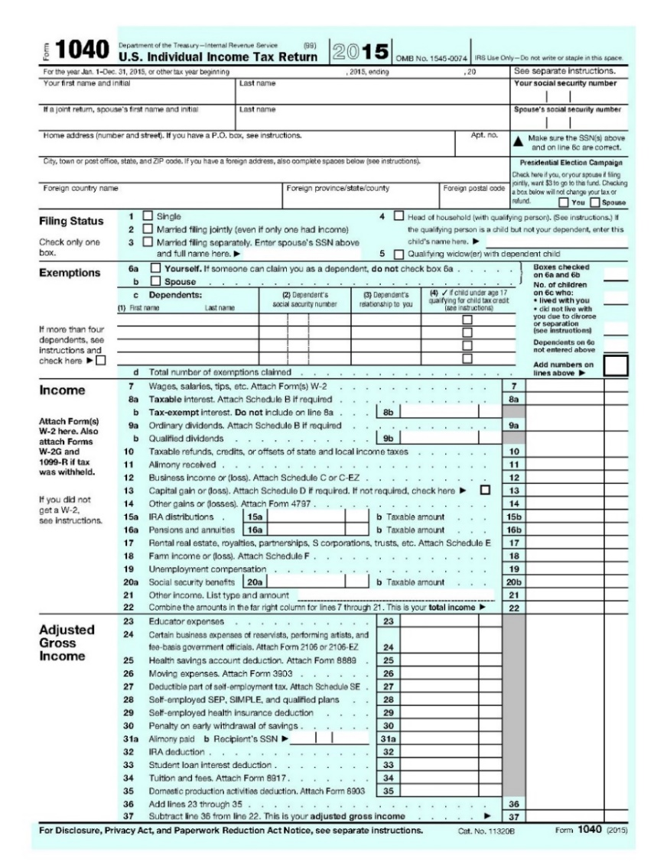
Documentation for Financial Aid
Example of the front page of a tax return
Preferred - Front page of MOST RECENT processed tax return with Social Security Numbers blacked out. (Tax return must include child named above as dependent on taxes)
Proof child receives SSI
Proof child receives Free/Reduced lunch
Proof of SNAP benefits/Medicaid benefits
Submitted tax document must include child with autism
Page must include Adjusted Gross Income
Notes:
For information about alternate accepted documentation for Financial Aid consideration, please contact the office: (850) 434-7171.

Slide 12
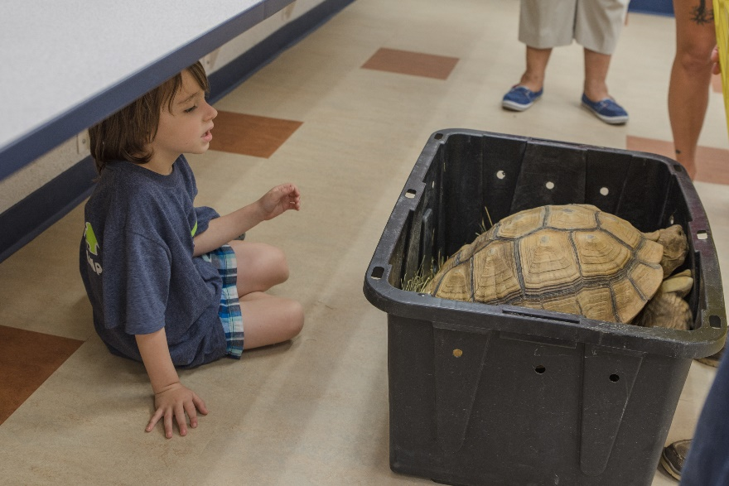
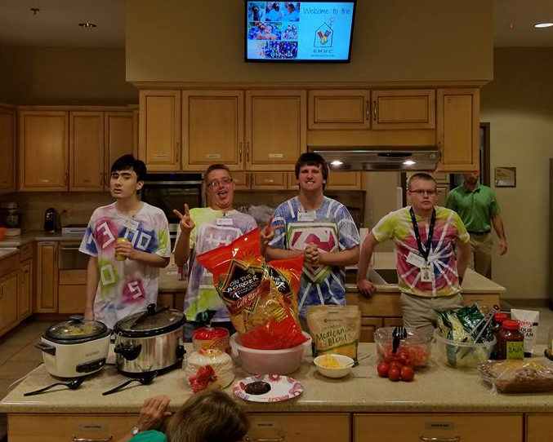
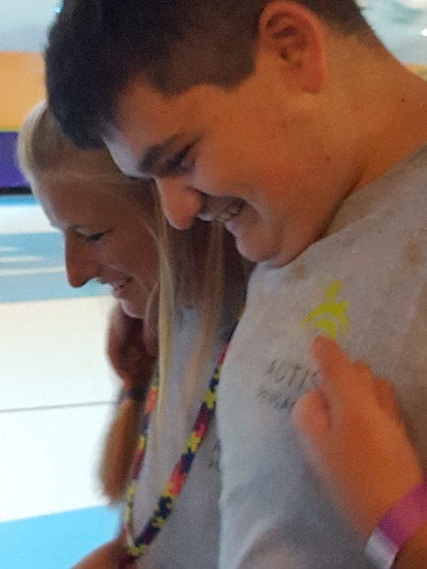
OPTIONAL PROGRAMS
Typical Siblings and Friends (Elementary Peers)
For ages 6 to 12
Reverse-inclusion opportunity
One-week commitment
Fee for program
Extended Care
Before and after care for campers and elementary peers
Only available at Holm campus and Washington campus
Fee to participate
Notes:
#11 and #12 in Policies & Procedures
Fees attached to each program

Slide 13
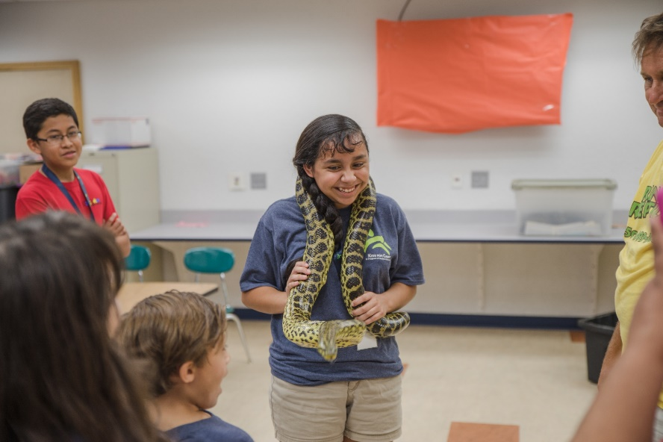
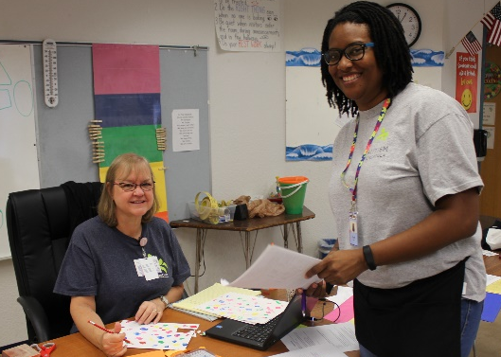
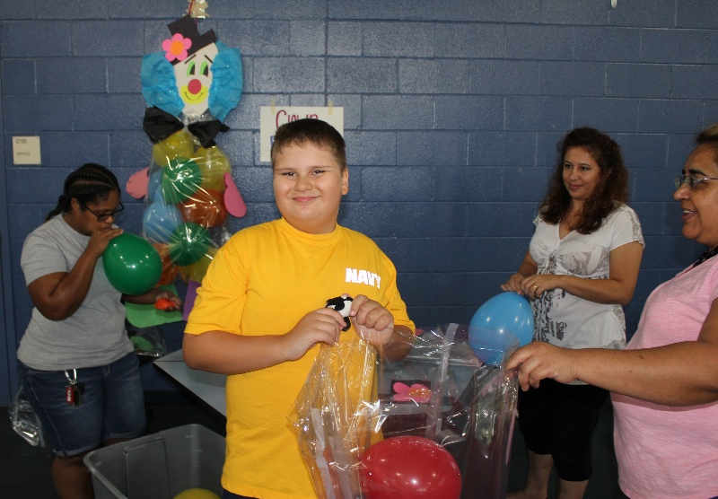
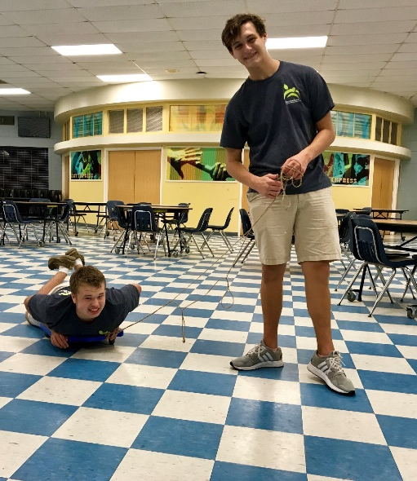
Teen Peer Details
Must be between the ages of 12 to 18 (or completion of high school)
Commit to attend one week of camp
Free to participate
Earn volunteer hours
Notes:
#13 in Policies & Procedures

Slide 14
Reasons to Volunteer
We need your passion!
Meeting people and having fun are good reasons to volunteer.
You want to give back to an organization that has impacted your life.
You want to make a difference in the autism community
It’s a great excuse to socialize
Notes:
Volunteering through different programs lets you be devoted to a cause that's close to your heart while spreading that passion to others.
Each camp family has a 10 hour volunteer commitment to Kids for Camp
Minimum of 10 hours of volunteer work
Fee of $150 in lieu of volunteering
Volunteerism is required of all camp families
Penalties may be assessed for failure to fulfill the volunteer requirement and will reflect negatively during application period the following year.

Slide 15
Families will be notified by mid-April of camp acceptance
Enrollment form
Tuition statement
Optional programs forms
All enrollment paperwork must be submitted by April 24th
Notes:
#6 on Policies & Procedures
Tuition must be paid IN FULL before camp begins - #7 on P&P
Payment due dates: May 1st and June 1st
Fees for optional programs are due as noted on the applications

Slide 16
FINAL REMINDERS
Questions?
Program Coordinator Shanan Chason at Shanan@autismpensacola.org
President/CEO Cate Merrill at Cate@autismpensacola.org
Office Assistant Jena Sudderth at Jena@autismpensacola.org
Application deadline is Feb. 28
Applications available online and in the office
Submit all paperwork and payments by deadlines
Volunteer time can be earned now! Email the office to get involved

